Slide 1
Nasdanika Foundation Server (NFS)
v. 0.1.0
Domain-Centric Web development

Slide 2
Overview
A full stack framework for building Java Web Applications running in an Equinox OSGi container.
EMF CDO repositories for object persistence.
Application/repository objects and services are accessible over HTTP through routes.
Fluent Java API for building HTML/Bootstrap UI and single-page applications.
Functional testing framework.
Application security model.
Workspace wizard generates application projects.

Slide 3
Logical architecture
HTTP
Routing servlet dispatches requests to application objects using routes.
Routing Servlet
Routes
CDO Repository
OSGi Service
POJO
CDO Object

Slide 4
Physical architecture: 1-tier
HTTP
OSGi Container
Routing Servlet
Routes
Services
CDO Client (Session Provider)
CDO Server & Repository
Embedded
database

Slide 5
Physical architecture: 2-tier
HTTP
OSGi Container
Routing Servlet
Routes
Services
CDO Client (Session Provider)
CDO Server & Repository
Database

Slide 6
Physical architecture: 3-tier
HTTP
HTTP
OSGi Container
OSGi Container
Routing Servlet
Routing Servlet
Routes
Routes
Services
Services
CDO Client (Session Provider)
CDO Client (Session Provider)
TCP/IP
OSGi Container
CDO Server & Repository
Database

Slide 7
Physical architecture: n-tier
HTTP
Routing Servlet
Routes
Services
Eclipse Communication Framework
Services
CDO Client (Session Provider)
TCP/IP
CDO Server & Repository
Database

Slide 8

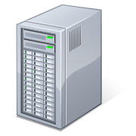

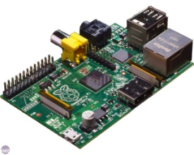
Configuration Management
Desktop
Source
Repositories
Binary
Repositories
Products
Developer
Server
Bundles
Build Server
Cloud
IoT

Slide 9
Example
IoT

Slide 10
NFS and the Cloud
NFS/Equinox product
Contains native launchers
Can be bundled with JRE
Can be deployed to an IaaS cloud
NFS/Equinox product with provisioning bundles
Can be considered a PaaS cloud of bundles
Hot deployment
Push – installation of new bundles/features
Pull – check for updates
NFS/Equinox product/application deployed to an IaaS cloud can be considered a SaaS cloud.
SaaS
Nasdanika Foundation Server Product
Binary
Repositories
Provisioning
Bundle
…
Bundles/Features
Bundle
Bundle
Bundle
IaaS

Slide 11
Routes
Types
Root route – matches a path pattern, can delegate to object routes.
Object route – matches a path pattern in the context of an object, can delegate to other object routes.
Extension route – matches extension.
Registration
Eclipse extension
OSGi service
Method annotations

Slide 12
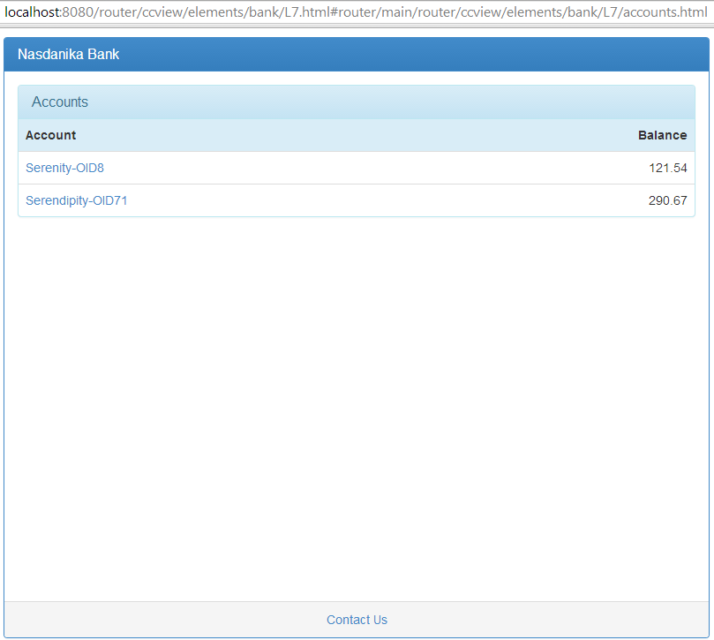
Routing example
router – Alias of the routing servlet
ccview – Matches CDO View root route
elements/bank – Matches CDO repository resource with the name “bank”
L7 – Matches Customer object by its CDO ID
accounts.html – matches Customer’s routing method

Slide 13
Out of the box routes
CDO View/Transaction route – a root route that creates a View/Transaction context and delegates to object routes matching repository elements.
CDO Resource route – resolves resource objects and delegates to objects’ routes.
Object route – allows to access fields, invoke methods, load classloader resources relative to object’s class and absolute. Relative resource resolution traverses inheritance hierarchy.
EObject route – extends object route, provides access to attributes, references, and operations. Elements in “many” references are addressed by index, in EMap references by the key or by index.
Array, List, and Map routes – resolve collection elements by index or key.
Service route – root or object route which allows to invoke OSGi service methods

Slide 14
Security
Application code checks for permissions to execute actions on objects.
Security Policy groups fine-grained permissions into coarse grained permissions (roles) – implies/implied-by relationship.
Permissions can be granted to users and groups.
Security policy is declarative – it can be installed as an extension or a service or be stored in a CDO repository.
An application may be packaged with different security policies.
Permissions can have conditions, e.g. funds transfer permission may use transfer amount in its condition.

Slide 15
Polymorphic Web UI
HTML Factory - easily construct responsive Bootstrap-based Single Page Applications (SPA).
(E)Object can “host” one or more SPA’s.
Resource inheritance and method overriding – UI can be built in OO-way, e.g.
Base Account object provides a route for account summary panel.
Credit Card Account “overrides” icon resource of the Base Account and/or methods used in constructing the summary panel.

Slide 16
Functional Testing
Tests can be implemented as a fragment of the application plugin or as a standalone product.
Nasdanika WebTest framework provides means for building modular functional tests and generates HTML report with screenshots organized into slideshows.

Slide 17
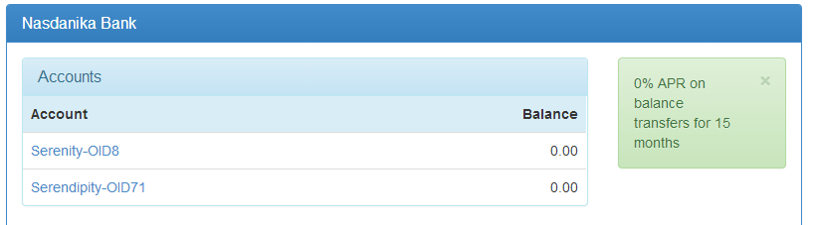
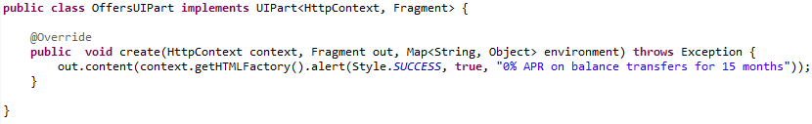
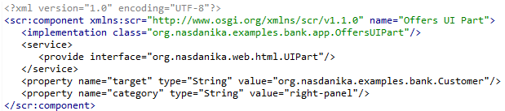
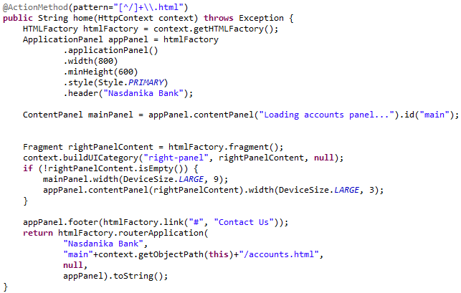
UI Part
The Whiteboard pattern for UI construction
UI parts implementations
OSGi service
Eclipse extension
Defined for a target class and category
Invoked through WebContext.buildUICategory

Slide 18
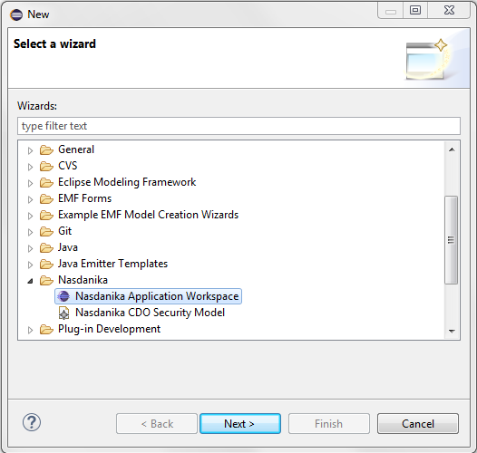
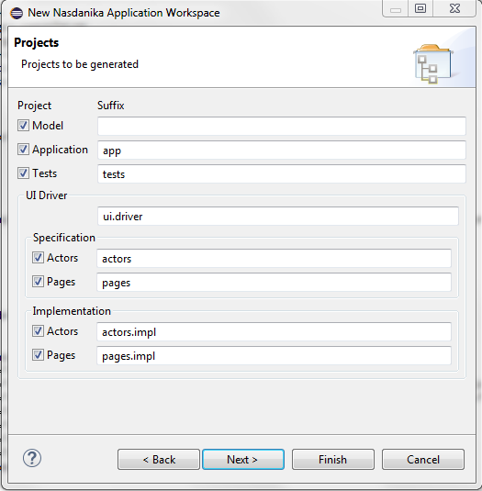
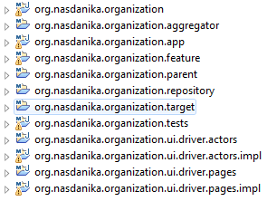
Set up workspace(s)
Install Nasdanika Workspace Wizard from http://www.nasdanika.org/server/repository
Install Maven Integration For Eclipse from the Eclipse Marketplace
Generate workspace projects – all in one workspace, or several workspaces.
A workspace is buildable and executable after generation – a “Walking Skeleton” of the future system.

Slide 19
References
Sources – https://github.com/Nasdanika/server
Wiki – https://github.com/Nasdanika/server/wiki
P2 repository - http://www.nasdanika.org/repository
Nasdanika HTML presentation - http://www.slideshare.net/PavelVlasov2/nasdanika-html-fluent-java-api-for-building-htmlbootstrap-web-ui

